Slide 1
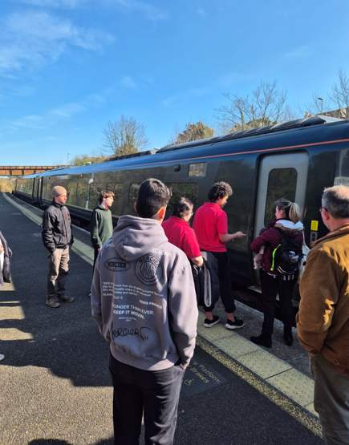
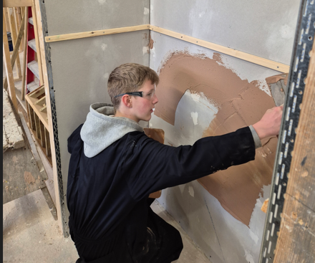
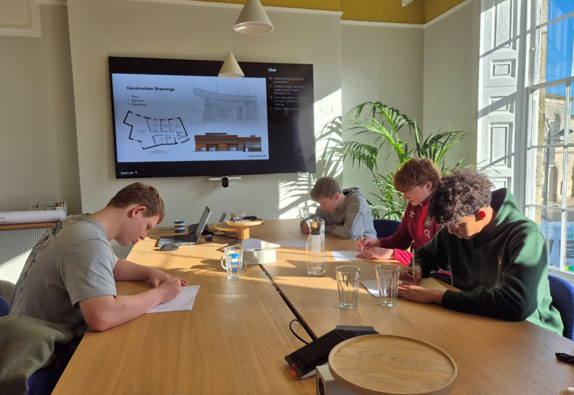
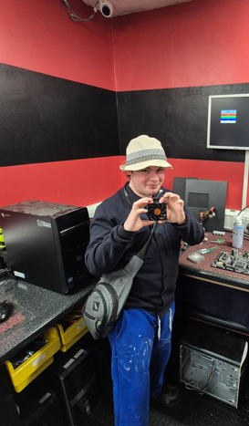
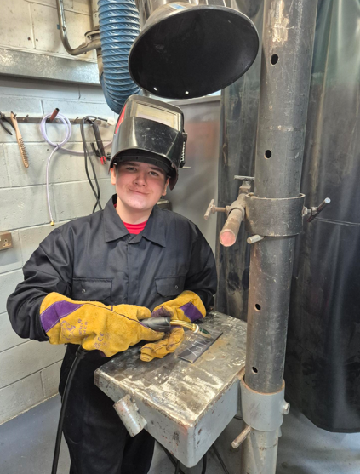
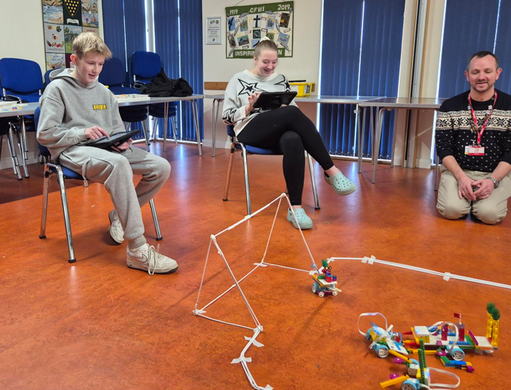
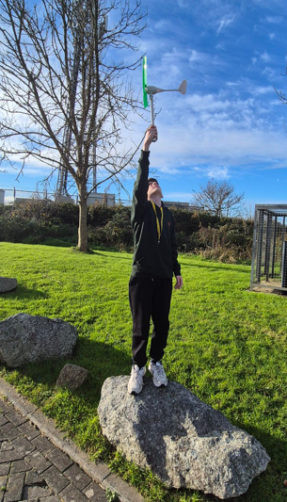

Slide 2

Careers Programme 2024-25

Slide 3
Session Objectives
The aim of this short presentation is to provide an overview of the careers programme at Oak Tree School.
By the end of this session, you should be able to:
Identify why we have a careers programme.
Identify a range of benefits of having a careers programme in school.
Describe what the Gatsby Benchmarks are and the importance of these in relation to our careers programme.
Summarise what we currently do at Oak Tree School in our careers programme.
Identify targets set out in the careers quality improvement plan.

Slide 4
Why do we have a Careers Programme?
Section 45A of the Education Act 1997 requires all schools and education providers to have a stable, structured careers programme that has the explicit backing of the senior management team and has an identified and appropriately trained person responsible for it.
Research suggests that careers related learning in schools help raise aspirations and support children's transitions to secondary school and beyond.
Ofsted inspects and grades careers programs in schools, evaluating them as part of the school's overall effectiveness, focusing on areas like personal development and leadership and management.
Career education and guidance play an important role in curriculum that supports: students' interests, strengths and aspirations, students' achievements, students at risk of poor outcomes, students making informed decisions about their subject choices and pathways.

Slide 5
Benefits of the Careers & Education Programme at School?
There are many benefits of us delivering careers education in school. These include:
Improved self-awareness: Careers education can help students to gain a better understanding of their own strengths, weaknesses, and interests. This can help them to make more informed choices about their future career paths.
Increased motivation: When students have a clear idea of what they want to do in the future, they are often more motivated to work hard in school and achieve their goals. Students can see the relevance of their school subjects to real world careers.
Better decision-making: With a solid understanding of the different career options available to them, students are better equipped to make informed decisions about their education and career paths.
Greater career satisfaction: Careers education can help students to identify careers that are a good match for their skills and interests, which can lead to greater job satisfaction and fulfilment.
Reduced skills gap: By providing students with information about in-demand careers and the skills required to succeed in those careers, careers education can help to reduce the skills gap between the workforce and the needs of employers.
Enhanced employability: With knowledge of the job market, interview skills, CV preparation, networking skills and communication skills, students become better equipped to successfully navigate the job application process and compete effectively for job opportunities.

Slide 6
What are the Gatsby Benchmarks?
Non-statutory but internationally recognised set of standards which provide schools and colleges with a framework in which to develop their careers programme in line with their legal requirements.
The 8 Gatsby benchmarks of good career guidance are:
1. A stable careers programme.
2. Learning from career and labour market information.
3. Addressing the needs of each pupil.
4. Linking curriculum learning to careers.
5. Encounters with employers and employees.
6. Experiences of workplaces.
7. Encounters with further and higher education.
8. Personal guidance.

Slide 7
1. A Stable Careers Programme
Definition | Criteria
Every school should have an embedded programme of careers education and guidance that is known and understood by pupils, parents and carers, staff, governors, employers and other agencies. | • The Every school should have a stable, structured careers programme that has the explicit backing of governors, the headteacher and the senior management team, and has an identified and appropriately trained careers leader responsible for it. • The careers programme should be tailored to the needs of pupils, sequenced appropriately, underpinned by learning outcomes and linked to the whole-school development plan. It should also set out how parents and carers will be engaged throughout. • The careers programme should be published on the school’s website and communicated in ways that enable pupils, parents and carers, staff and employers to access, and understand it. • The programme should be regularly evaluated using feedback from pupils, parents and carers, teachers and other staff who support pupils, careers advisers and employers to increase its impact.

Slide 8
2. Learning from Careers & Labour Market Information
Definition | Criteria
All pupils, parents and carers, teachers and staff who support pupils should have access to good-quality, up-to-date information about future pathways, study options and labour market opportunities. Young people with special educational needs and disabilities (SEND) and their parents and carers may require different or additional information. All pupils will need the support of an informed adviser to make the best use of available information. | • During each Key Stage, all pupils should access and use information about careers, pathways and the labour market to inform their own decisions on study options or next steps. • Parents and carers should be encouraged and supported to access and use information about careers, pathways and the labour market to inform their support for pupils in their care.

Slide 9
3. Addressing the Needs of Each Pupil
Definition | Criteria
Pupils have different careers guidance needs at different stages. Careers programmes should help pupils navigate their concerns about any barriers to career progression. In addition, opportunities should be tailored to the needs of each pupil, including any additional needs of vulnerable and disadvantaged pupils, young people with SEND and those who are absent. | • A school’s careers programme should actively seek to challenge misconceptions and stereotypical thinking, showcase a diverse range of role models and raise aspirations. • Schools should keep systematic records of the participation of pupils in all aspects of their careers programme, including the individual advice given to each pupil, and any subsequent agreed decisions. • For pupils who change schools during the secondary phase, information about participation and the advice given previously should be integrated into a pupil’s records, where this information is made available. Records should begin to be kept from the first point of contact or from the point of transition. • All pupils should have access to these records and use them ahead of any key transition points to support their next steps and career development. • Schools should collect, maintain and use accurate data for each pupil on their aspirations, intended and immediate education, and training or employment destinations to inform personalised support. • Schools should use sustained and longer-term destination data as part of their evaluation process and use alumni to support their careers programme.

Slide 10
4. Linking Curriculum Learning to Careers
Definition | Criteria
As part of the school’s programme of careers education, all teachers should link curriculum learning with careers. Subject teachers should highlight the progression routes for their subject and the relevance of the knowledge and skills developed in their subject for a wide range of career pathways. | • Every year, in every subject, every pupil should have opportunities to learn how the knowledge and skills developed in that subject helps people to gain entry to, and be more effective workers within, a wide range of careers. • Careers should form part of the school’s ongoing staff development programme for teachers and all staff who support pupils.

Slide 11
5. Encounters with Employers & Employees
Definition | Criteria
Every pupil should have multiple opportunities to learn from employers about work, employment and the skills that are valued in the workplace. This can be through a range of enrichment opportunities, including visiting speakers, mentoring and enterprise schemes, and could include pupils’ own part-time employment where it exists. |  | Every student should have multiple opportunities to learn from employers about work, employment and the skills that are valued in the workplace. This can be through a range of enrichment activities including visiting speakers, mentoring and enterprise schemes, and should include students’ own part time employment where it exists. Every year, from the age of 11, pupils should participate in at least one meaningful encounter* with an employer. *A ‘meaningful encounter’ is one in which the student has the opportunity to learn about what work is like or what it takes to be successful in the workplace.

Slide 12
6. Experience of Workplaces
Definition | Criteria
Every pupil should have first-hand experiences of workplaces to help their exploration of career opportunities and expand their networks. | Every student should have first-hand experiences of the workplace through work visits, work shadowing and/or work experience to help their exploration of career opportunities, and expand their networks. By the age of 16, every pupil should have had at least one experience of a workplace, additional to any part-time jobs they may have.

Slide 13
7. Encounters with Further & Higher Education
Definition | Criteria
All pupils should understand the full range of learning opportunities that are available to them, including academic, technical and vocational routes. This should incorporate learning in schools, colleges, independent training providers (ITPs), universities and in the workplace. | • By the age of 16, every student should have had a meaningful encounter with providers of the full range of educational opportunities, including sixth forms, colleges, ITP’s, universities and apprenticeship providers. This should include the opportunity to meet both staff and students. Provider access legislation​ The provider access legislation is new guidance that comes into force from January 2023, which builds on Benchmark 7 and adds new specific requirements for schools. It is a key mechanism to further help learners understand and take-up, not just apprenticeships, but wider technical education options such as T-Levels and Higher Technical Qualifications. ​ The updated provider access legislation (PAL) specifies schools must provide at least six encounters for all their students: ​ Two encounters for pupils during the ‘first key phase’ (year 8 or 9) that are mandatory for all pupils to attend ​ Two encounters for pupils during the ‘second key phase’ (year 10 or 11) that are mandatory for all pupils to attend ​

Slide 14


8. Personal Guidance
Definition | Criteria
Every pupil should have opportunities for guidance meetings with a careers adviser, who could be internal (a member of school staff) or external, provided they are trained to an appropriate level. These meetings should be available for all pupils whenever significant study or career choices are being made. They should be expected for all pupils but should be scheduled to meet their individual needs. The careers leader should work closely with the careers adviser, SEND coordinator (SENDCO) and other key staff to ensure personal guidance is effective and embedded in the careers programme. | • Every pupil should have at least one personal guidance meeting with a careers adviser by the age of 16, and a further meeting by the age of 18. Meetings should be scheduled in the careers programme to meet the needs of pupils. • Information about personal guidance support and how to access it should be communicated to pupils and parents and carers, including through the school website.

Slide 15
How do we Currently Deliver our Careers Programme?
From years 7 onwards, all children will access the “Incredible Futures” curriculum (Plans for Primary Curriculum currently in place for later in 25/26)
Careers is embedded across the wider school curriculum
Alternative provision with external providers e.g. Cornwall College
Encounters with employers and work experience
Participation in National Careers Week
Independent advice and guidance provided by Cornwall County Council and Regional Futures Lead (Olly Masters)
Visits to further education and training providers
Partnerships with external stakeholders such as Job Centre Plus, Cornwall & Isles of Scilly Careers Hub
Information and resources available to students, parents, staff and employers on the school website.
Careers forms part of the school quality assurance process
Post -16 transition event & options evening
Post-16 transition activities

Slide 16
Evidence of Careers Work
Incredible Futures curriculum work stored in individual student portfolios.
Work experience and Cornwall College log books.
Individual student activity related to meeting the Gatsby Benchmarks will be recorded on Unifrog which the school has just purchased.
Copies of parent/staff/student questionnaires and feedback
Photographic evidence against the Gatsby Benchmarks stored on Unifrog
Learning walks and teaching observations capture evidence of careers related learning.
Careers will be embedded across all curriculum areas and evidenced in the new planning documents.
School website includes statutory information such as the careers policy and provider access statement as well as information for parents and students.
Completion of annual careers audit from Oli Masters and Compass self evaluation tool.

Slide 17
Careers Development Plan 25-26
Overview of Targets:
1. To develop how we link curriculum learning to careers across the wider school curriculum. (GB4)
2. To increase the number of learners who gain first hand experiences of work places to support their exploration of career opportunities and expand their networks. (GB 6)
3. To develop an effective method of tracking careers activity for individual learners in line with meeting the Gatsby Benchmarks and CDi and Skills Builder framework.
4. To embed the CDi and Skills Builder framework into the wider school curriculum.
5. To continue working towards the Quality in Careers Standard.
6. To develop individual learner action plans to evidence personal advice and guidance which are signed, dated and shared with the students, parents/carers, and the transition team. (GB8)
7. To increase the opportunities for learners to learn from employers about work, employment and the skills valued in the workplace. (GB 5)

